Slide 1
Industrial
Training 2022-23
~ Mr. Sarthak Bangar ….

Slide 2
Government Polytechnic Awasari (KH)
Department of Information Technology
Summer Internship / In-plant Training Presentation
Name of Organization ~ Hindustan Informatics | Expert IT
Date ~ 4th July 2022 to 14th August 2022
Name of Student ~ Sarthak Bangar

Slide 3
Company Overview
Company Name ~ Expert IT & Hindustan Informatics
Address ~ 2nd Floor Madhav Bag Residency, Gopal Patti , Manjari Bk..412307
Contact ~ +91 90750 80428 +91 87966 48021
Name of Contact Person ~ Mr. Amol Bhujabal Sir
Designation ~ Sr. Developer
Website ~ https://expertit.in/

Slide 4





Agenda
1.
Linux
2. HTML
3. CSS
4. GitHub
JavaScript

Slide 5
1. Linux
Ubuntu is a Linux-based operating system. It is designed for computers, smartphones, and network servers.
The system is developed by a UK based company called Canonical Ltd.
All the principles used to develop the Ubuntu software are based on the principles of Open Source software development.

Slide 6
2. HTML
HTML stands for Hyper Text Markup Language. It is used to design web pages using a markup language.
HTML is the combination of Hypertext and Markup language.
Hypertext defines the link between web pages.
A markup language is used to define the text document within the tag which defines the structure of web pages.
The language uses tags to define what manipulation has to be done on the text.

Slide 7
3. CSS
Cascading Style Sheets, fondly referred to as CSS, is a simple design language intended to
simplify the process of making web pages presentable.
- Using CSS, you can control the color of the text, the
style of fonts, the spacing between paragraphs, how
columns are sized and laid out, what background
images or colors are used, layout designs, variations in
display for different devices and screen sizes as
well as a variety of other effects.
Most commonly, CSS is combined with the markup languages HTML or XHTML.

Slide 8
4. GitHub
GitHub is an immense platform for code hosting. It supports version controlling and collaboration and allows developers to work together on projects.
Essential components of the GitHub are:
Repositories
Branches
Commits
Pull Requests
Git (the version control tool GitHub is built on)

Slide 9
5. JavaScript
JavaScript (JS) is a light-weight object-oriented
programming language which is used by several
websites for scripting the webpages.
- It is an interpreted, full-fledged programming
language that enables dynamic interactivity on
websites when applied to an HTML document.
In addition to web browsers, databases such as
CouchDB and MongoDB uses JavaScript as their
scripting and query language.

Slide 10
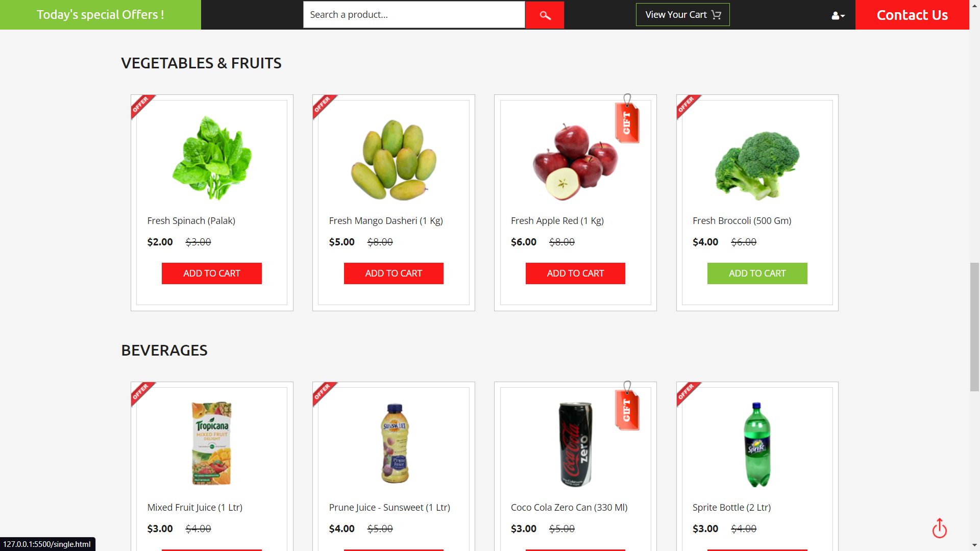
Event Listener - Onclick , Onblur , Ondbclick
Onfocus , Onload , OnKeyup,
Tag - <a>….. </a> , <div>….</ div> ,
<script>….</script> , <span>….</span>
Element – Label , Button , Radio Button , Text ,
Text-Area

Slide 11
Thanks Youuu…

